Slide 1
DYNAMIC FRACTURE MODELS topics for discussion
may 7, 2024
Renato poli

Slide 2
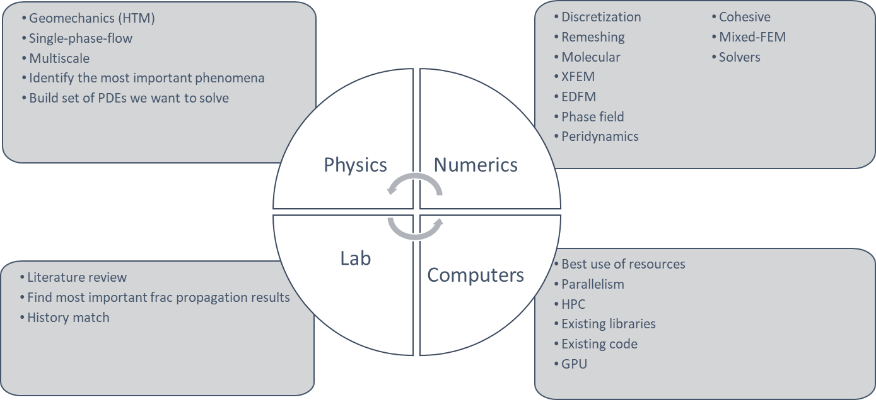
TECHNOLOGY AXES

Slide 3
PROBLEM FRAME
Conventional reservoirs
Naturally fractured
Layered
Salt or shale caprock
High temperature contrast
PROBLEM
SOLUTION

Slide 4

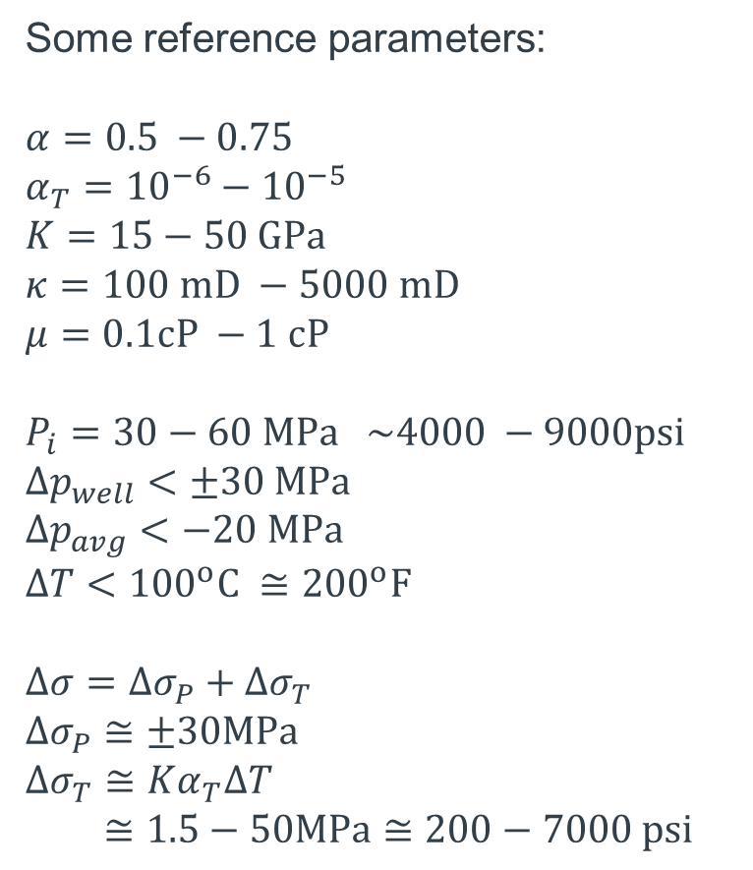

LOCALIZATION OF THE INVESTIGATION
Some reference parameters:
$$α=0.5 −0.75$$
$$α_{T}={10}^{−6}−{10}^{−5}$$
$$K=15−50 GPa$$
$$κ=100 mD −5000 mD$$
$$μ=0.1cP −1 cP$$
$$P_{i}=30−60 MPa \sim 4000 −9000psi$$
$$Δp_{well}<±30 MPa$$
$$Δp_{avg}<−20 MPa$$
$$ΔT<{100}^{o}C ≅{200}^{o}F$$
$$∆σ=∆σ_{P}+∆σ_{T}$$
$$∆σ_{P}≅±30MPa$$
$$∆σ_{T}≅Kα_{T}ΔT$$
$≅1.5−50MPa≅200−7000 psi$
$$1−2 km$$
$$<300 m$$
Notes:
FLUID FRONT IN BLUE
TEMPERATURE FRONT IN RED

Slide 5
THE IMPACT OF FRACTURE DYNAMICS
Some reference parameters:
$$α=0.5 −0.75$$
$$α_{T}={10}^{−6}−{10}^{−5}$$
$$K=15−50 GPa$$
$$κ=100 mD −5000 mD$$
$$μ=0.1cP −1 cP$$
$$P_{i}=30−60 MPa \sim 4000 −9000psi$$
$$Δp_{well}<±30 MPa$$
$$Δp_{avg}<−20 MPa$$
$$ΔT<{100}^{o}C ≅{200}^{o}F$$
$$∆σ=∆σ_{P}+∆σ_{T}$$
$$∆σ_{P}≅±30MPa$$
$$∆σ_{T}≅Kα_{T}ΔT$$
$≅1.5−50MPa≅200−7000 psi$
$$1−2 km$$
$$<300 m$$
Notes:
WHICH FRACTURE DYNAMICS SHOULD WE STUDY?

Slide 6
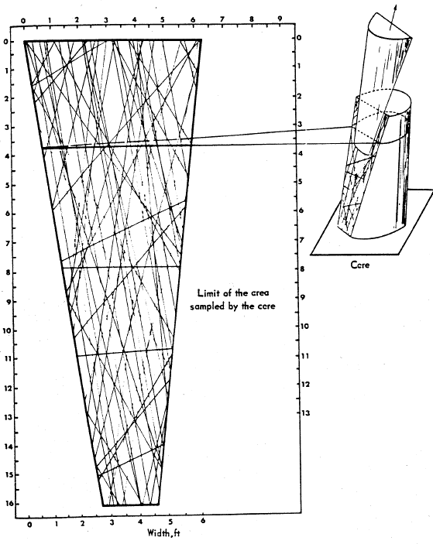
THE SCALE OF FRACTURES
Notes:
WE NEED TO CONSIDER OUR ENTITIES AS NUMERICAL ABSTRACTIONS.

Slide 7



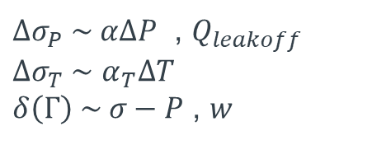
THE FRACTURE PHYSICS
$$∆σ=∆σ_{P}+∆σ_{T}$$
$$P(Γ)≤σ(Γ)$$
$$w(Γ)$$
$$δ(Γ)$$
$∆σ_{P} \sim α∆P$ , $Q_{leakoff}$
$∆σ_{T} \sim$ $α_{T}∆T$
$δ\left(Γ\right) \sim σ−P$ , $w$

Slide 8
FRACTURE TRANSMISSIBLITY?
It is very difficult to apply the cubic law in a unpropped natural fractures
The uncertainty is too high.
Suggestion: derive from data
(however) Which observable field data contains this information?

Slide 9


FRACTURE INTERACTION IN CONVENTIONALS
$$σ_{max}$$
$$σ_{min}$$
Notes:
WHEN ONLY PRESSURE IS CONSIDERED, THE PREFERENTIAL PROPAGATION DIRECTION DOES NOT CHANGE

Slide 10
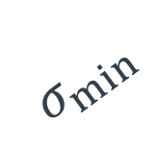


FRACTURE INTERACTION IN CONVENTIONALS
$$ΔT$$
$$σ_{max}$$
$$σ_{min}$$
Notes:
WHILE THE PRESSURE RISE INCREASES THE CONTRAST, THE TEMPERATURE REDUCTION DECREASES THE CONTRAST CAUSING BRANCHING

Slide 11
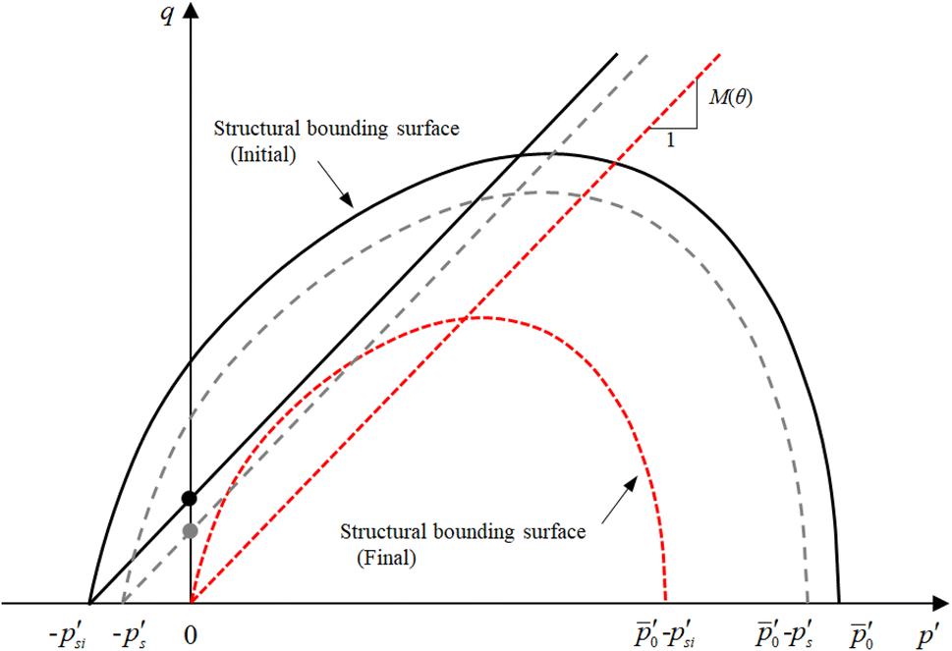
PLASTICITY
Notes:
THE HIGH STRAIN AROUND THE FRACTURE IS CRITICAL FOR THE ROCK STRUCTURE.
PLASTICITY IS LIKELY TO HAPPEN AND CHANGE THE PROPERTIES DYNAMICALLY

Slide 12
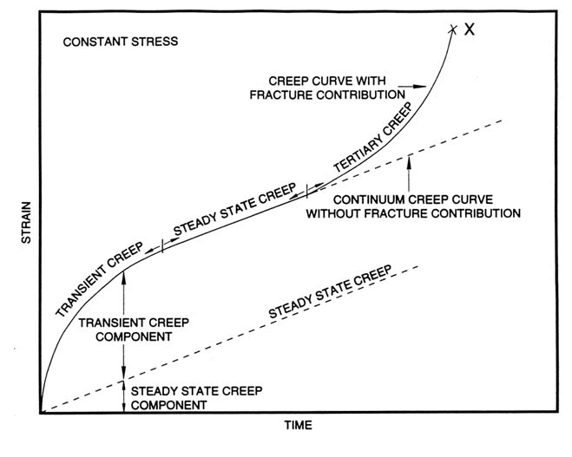
SALT CREEP
Notes:
SALT IS A CAPROCK IN PRE-SALT FIELDS
IT IS ALSO IMPORTANT TO INVESTIGATE CREEP IF WE ARE TO MODEL MECHANICS OF SALT CAVERNS

Slide 13
OPEN STATEMENTS TO INVESTIGATE
CLAIM | Maturity
PHYSICS
Multiphase flow does not impact fracture propagation as long as we estimate the global temperature and pressure fields well. | Believe
Multiphase flow has limitations when using EDFM in NFR due to the upwind numerical strategies of the commercial simulators. | Believe. Need to investigate.
The fracture dynamics we are interested in (NF distributed along the reservoir, temperature-driven) are not planar. Branching and fracture swarms are a fact. | Evidence
LEFM is insufficient for fracture propagation in conventional reservoirs, and plasticity plays a role. | Don't know. Need to investigate
Creep is important to model fracture propagation in a salt layer, as it acts within minutes-to-hours. | Believe
Reactive transport does not play a role in propagation but may fill the fracture and reduce permeability. | Believe
Fracture propagation characteristic time concur with pressure diffusion in early times or with high-efficiency fluids (fully coupling may apply). Higher times are expected otherwise (weak coupling is enough) | Believe

Slide 14
OPEN STATEMENTS TO INVESTIGATE
CLAIM | Maturity
NUMERICS
Only small-scale meshes can deal with the complex physics of fracture propagation. | Believe
EDFM works in coarse meshes and has no resolution to model physics behind fracture propagation driven by low-efficiency fluids. In fine meshes, we know better technology. | Believe. Do we have enough evidence from Lily's work?
Phase field models are expensive for 3D models because they require high resolution to map a 2D mesh in volumes. We do not know any technology to overcome that. | Believe
FEM provides more mathematical flexibility than FVM and FDM to work with fracture mechanics. | Believe
We can numerically estimate the velocity vector at the tip of an existing fracture, which can be mapped to a point (2D domain) or a line (3D domain). | Don't know. Need to investigate.
We can numerically estimate a nucleation vector in any point P of the continua. | Don't know. Need to investigate.
Conforming meshes require remeshing but are still less expensive because they explicitly represent the fracture domain. | Believe
Non-conforming meshes are less expensive because they do not require remeshing. The technologies are ILSA, XFEM, Phase-field, SBFEM. | Evidence
Non-conforming meshes have difficulty dealing with fracture interaction because they need to embed complex scenarios into the equations. (no explicit fracture representation) | Evidence

Slide 15
OPEN STATEMENTS TO INVESTIGATE
CLAIM | Maturity
APPLICATIONS
NF opening or new fractures propagating as a strain release mechanism due to low-temperature fluid injection. | Believe
Natural fractures closure due to reservoir depletion. | Evidence. Simple tables in flow simulators can handle effectively.
Cold drilling fluids are enough to fracture the rock even in original pressure. | Believe
Salt cavern fracture analysis for safety needs hundreds to thousands of years. | Evidence. Does any simulator can handle this?
Secondary fractures in geothermal systems due to the pressure gradient. | Evidence
Increase in HF effective stress due to depletion, causing proppant crushing | Evidence. Existing simulators can handle effectively.

